Slide 1
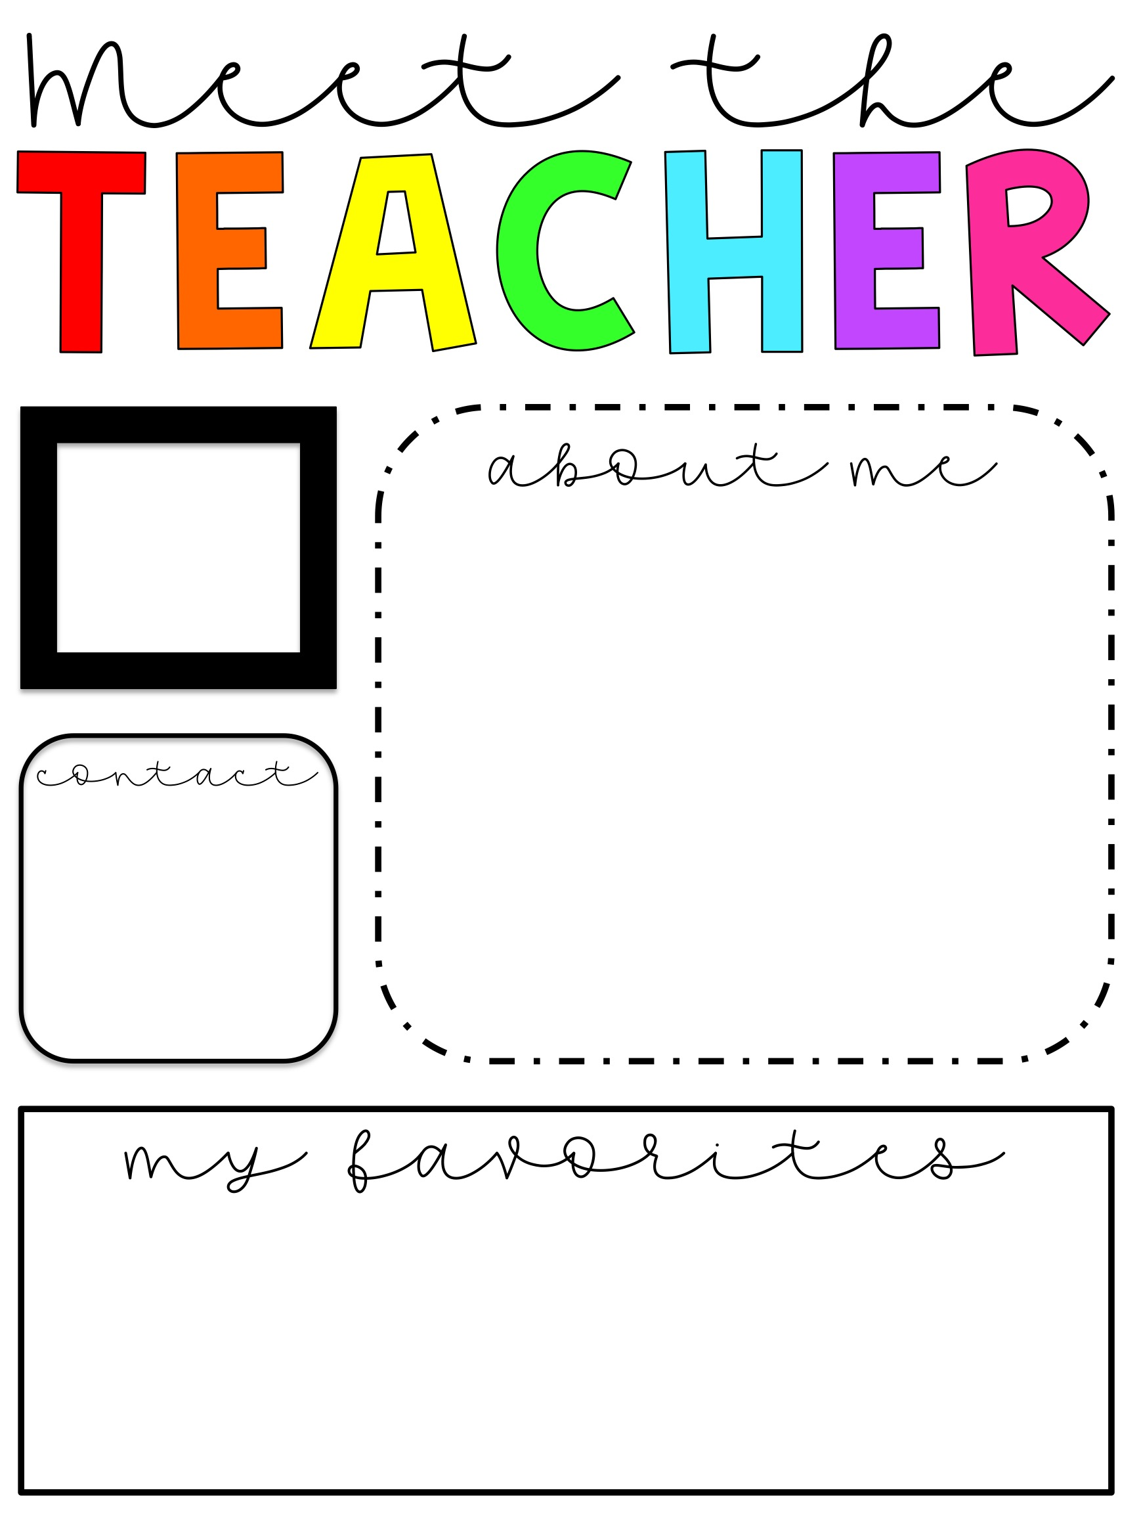
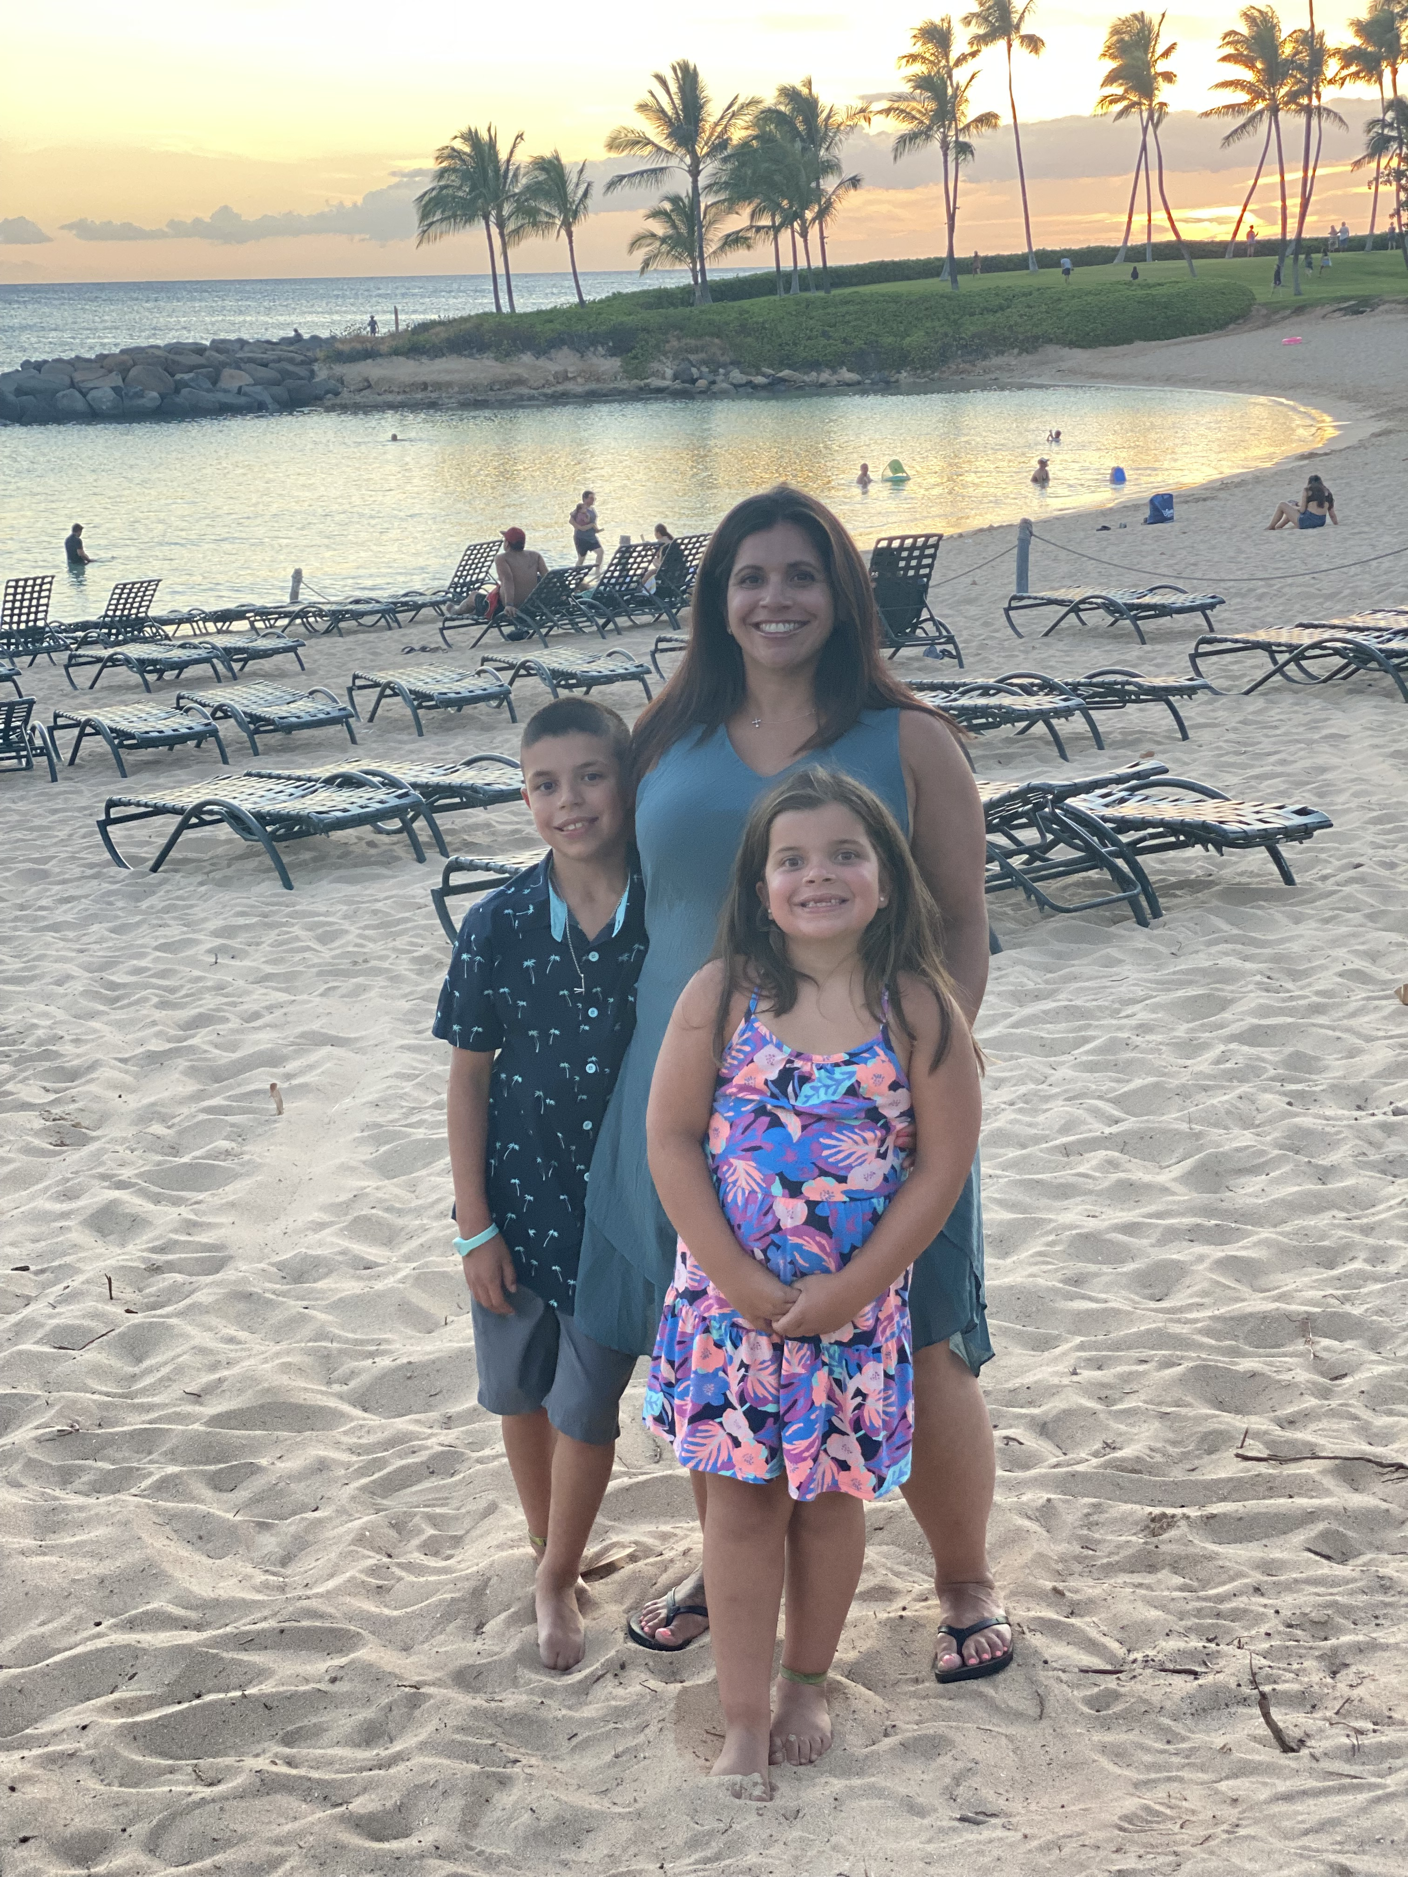
Insert picture here
Welcome to the 2021-2022 school year. My name is Ms. Smith. I have taught students with autism for 16 years. I have my credential, masters and an administrative credential. I have a10 year-old son and 7-year-old daughter. I know last school year was different for all of us so I am looking forward to having the kids back at school! Thank you for all your continued work and support! Let’s make this year AMAZING!
Email: Adrienne_Smith@chino.k12.ca.us
Class Dojo
Color: Purple and Red
Animal: Dog
Favorite Place: Hawaii, the beach, mountains
Candy: Sour Candy
Food: Chips and salsa
Drink: Water and Ice Tea

